Slide 1
Version Control
Git & GitHub
Version Control for Data Scientists & Data Analysts

Slide 2
Table of Content
Introduction to Version Control with Git and GitHub
1.Overview
2.Version Control (What and Why)
2. Git installing walk through
3. Source code hosting Services
4. GitHub Account and Types
5. Introduction to Git
6. Git Configuration
7. Working with a Local Repository
8. Git Workflow
9. Basic Git Commands
10. Link to a version Control Book (O’Reilly)

Slide 3
Overview
This course introduces Data Analysts and Data Scientists to the basics of version control with Git and GitHub. Participants will learn how to set up Git, track changes in code and data projects, and connect with GitHub for backing up and sharing work. We'll cover essential Git commands, along with simple collaboration techniques. By the end, you'll have the foundational skills to manage your data projects more efficiently and work smoothly with others.

Slide 4
Version Control [What and Why]
Version Control (VC): This is a system that records changes to files over time, allowing you to track modifications, revert to previous versions, and collaborate effectively with others.
Version Control Systems (VCS): These are tools that help manage changes to source code or documents. They keep track of every modification, so you can easily revert to earlier states or review the history of changes. Examples: Git, Subversion (SVN) and many more.
Types of Version Control:
1. Local Version Control: Keeps track of changes in a single user’s machine.
2. Centralized Version Control: Involves a central server that holds all the versioned files and allows multiple users to collaborate.
3. Distributed Version Control: Each user has a full copy of the repository on their local machine, enabling them to work independently and merge changes later.

Slide 5
Version Control [What and Why]
Why Use Version Control?
1. Collaboration: Multiple team members can work on the same project simultaneously without overwriting each other’s changes. This is essential for teams where members contribute code or content.
2. History Tracking: You can track who made changes, what changes were made, and why. This history is invaluable for understanding the evolution of a project.
3. Reverting Changes: If a mistake is made, version control allows you to roll back to previous versions quickly, minimizing disruption.
4. Branching and Merging: Developers can create branches to work on new features or fixes independently from the main project. Once completed, branches can be merged back into the main project, ensuring that new changes integrate smoothly.
5. Backup and Recovery: Your files are backed up in the repository, reducing the risk of data loss. If a file is deleted or corrupted, you can restore it from an earlier version.

Slide 6
Git Installation Walk Through
Documentation: https://git-scm.com/book/en/v2/Getting-Started-Installing-Git
Windows installation : Use the documentation or the Youtube video below.
YouTube video guide: https://youtu.be/cJTXh7g-uCM?si=zxv0Z9yiVTr3txek
Linux installation : Usually comes with Git pre-installed. You can check it by typing the command git –version YouTube video guide: https://youtu.be/_kAV059yZ_s?si=BYunQjJFAOZKCMpI
MACOS : Usually comes with Git pre-installed. You can check it by typing the command git –version
Youtube Video guide: https: //youtu.be/B4qsvQ5IqWk?si=m1QCzTX9Y42LdBnp

Slide 7
Source Code Hosting Services
Definition: Code hosting services (COS) are platforms that allow developers to store, manage, and collaborate on code. These services facilitate version control, enabling teams to track changes, manage multiple versions, and collaborate efficiently.
Why Use Source Code Hosting Services:
Collaboration: Multiple developers can work on the same project simultaneously, with tools for merging changes and resolving conflicts.
Version Control: These services help track changes over time, allowing developers to revert to previous versions if necessary.
Backup and Recovery: Source code is stored in the cloud, providing a reliable backup and making recovery easy in case of data loss.
Access Control: Permissions can be set to control who can view, edit, or manage the code, enhancing security.
Integration with CI/CD Tools: Many hosting services integrate with Continuous Integration/Continuous Deployment (CI/CD) tools, streamlining the development workflow.
Examples of popular source code hosting Services: GitHub, GitLab, Bitbucket, SourceForge, AWS CodeCommit.

Slide 8
GitHub Account
What is a GitHub Account?
A GitHub account is a personal or organizational profile that allows you to interact with GitHub, for hosting, sharing, and collaborating on code projects. By creating a GitHub account, you gain access to various features like version control, project management, issue tracking, and collaboration tools for software development.
Let’s see how to setup a GitHub visit: https://github.com/signup
Types of GitHub Accounts:
Personal Account:
Purpose: For individual users who want to store their code and collaborate on projects.
Features: You can create public and private repositories, contribute to open-source projects, and manage personal coding projects.
Free vs. Paid:
Free: Limited features (unlimited public/private repos but with restricted advanced options like larger storage).
Paid (GitHub Pro): Access to more advanced features like extra storage, detailed insights, and priority support.

Slide 9
Types of GitHub Accounts
2. Organization Account:
Purpose: For groups, companies, or teams to manage shared projects and collaborate.
Features: Organization accounts can have multiple users with different roles and permissions. These accounts are useful for managing larger team projects and access control.
Free vs. Paid:
Free: Limited team management features but suitable for smaller teams or open-source organizations.
Paid (GitHub Team/GitHub Enterprise): Advanced security, auditing, team management features, and larger storage limits for bigger organizations or businesses.
3. Enterprise Account:
Purpose: Tailored for large organizations or enterprises requiring robust security, compliance, and collaboration at scale.
Features: Enhanced security, single sign-on (SSO), advanced compliance features, priority support, and deployment of GitHub in a private infrastructure.
Paid Only: Comes under the GitHub Enterprise plan, which includes support and collaboration tools designed for scaling and privacy.

Slide 10
Introduction to Git
Git: Git is an open-source Distributed Version Control System (DVCS).
A version control system allows you to record changes to files over a period of time.
Git is used to maintain the historical and current versions of source code.
Git is designed for tracking changes in a project and facilitating collaboration among multiple contributors.
Local Repository vs Remote Repository
A repository (or repo) is a storage location for code, files, and project data managed by a version control system. It tracks changes to the project over time, enabling collaboration, versioning, and backups. A repository can be local (on your computer) or remote (hosted on a service like GitHub).
Local Repository: A version-controlled folder on your local machine where you track changes to your project files.
Pemote mote Repository: A version-controlled repository hosted (or stored) on a server (e.g., GitHub) that allows collaboration and sharing of code across multiple machines or users.

Slide 11
Git Configuration
This command lists all the current global configuration settings for Git on your system.
git config --global --list
This sets your Git username globally. This will be used as the author name for your commits.
git config --global user.name "your GitHub username"
This sets your Git email globally. This will be attached to your commits to identify the author.
git config --global user.email "your GitHub email address"
This sets the default branch name to 'main' for all new repositories you create.
git config --global init.defaultBranch main

Slide 12
To delete all Git Configuration
To delete all global Git configurations, you can remove the global Git configuration file entirely.
1. Remove the `.gitconfig` file: Run this command in the terminal:
rm ~/.gitconfig
2. On Windows, it’s located in your user directory, so you can delete it like this:
del $env:USERPROFILE\.gitconfig
3. Confirm Removal (Optional): To ensure all settings are cleared, you can list global configurations:
git config --list --global
This should return no output if everything has been deleted.

Slide 13
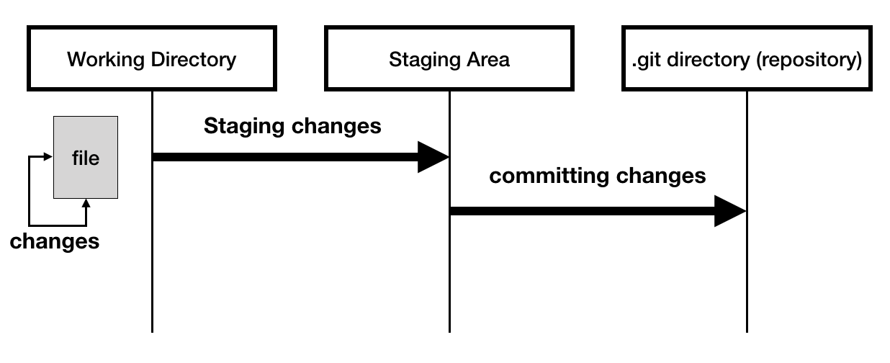
Working with a Local Repository
git init
This should create a .git folder, if it’s not there set your your view hidden folders command

Slide 14
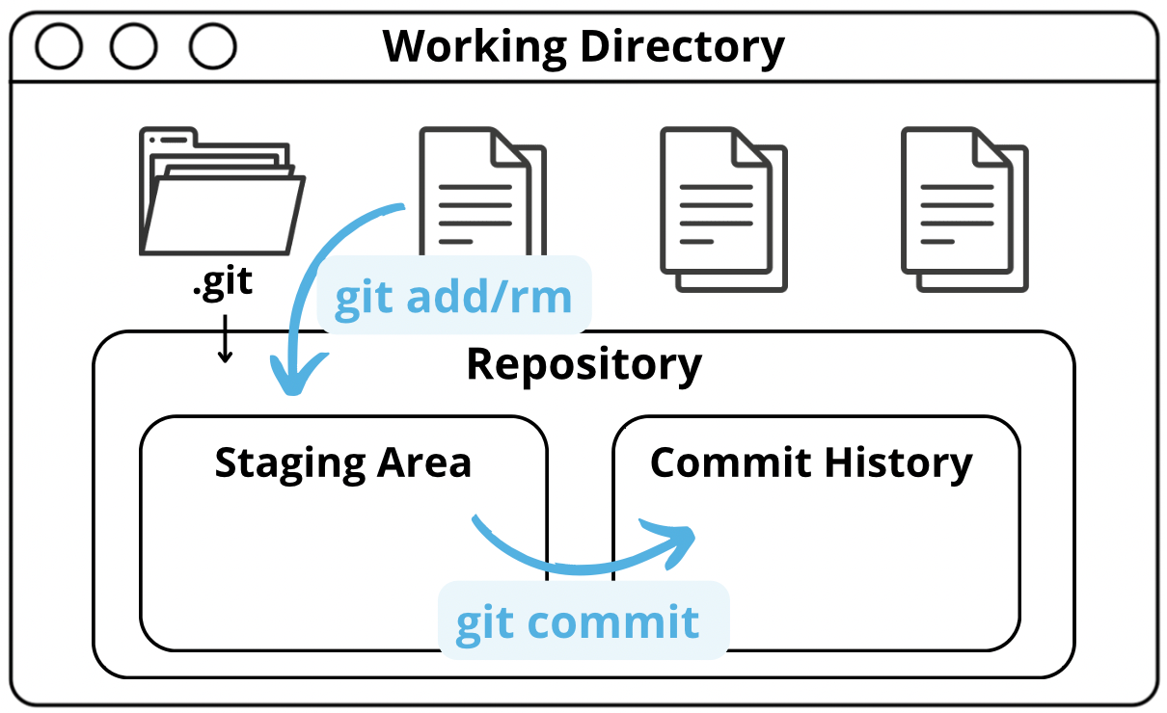
Git Workflow
git add <file name>
git add <file name> (or git add .)
git status (Shows tracked and untracked files)
git commit -m “Descriptive text for your commit” (This generates a 14 character hash id unique to your commit)
git log (This gives you the history of all commits )

Slide 15
Working with remote repository
Git and GitHub connection using Personal Access Token (PAT)
Go to GitHub and generate a personal acces token from Developer setting (Save it )
git remote add origin <repository address>
git remote -v
git push -u origin main (When error appears after this)
Remove your existing password from the credential service for windows
Open your keychain access (Delete git passwords if there are any)
git push -u origin main (Again)
it will ask you for user name and passward (Personal access token)

Slide 16
Basic Git Commands
git –version
git init
git add <file name>
git add .
git commint -m “Commit text”
git remote add origin <git address>
git push -u origin main
git push -u origin master (If your branch name is master you use)

Slide 17
Basic Git Commands (Cloning updating & Pushing)
Clone the repository
git clone <repository address>
Change directory into the cloned repository folder
cd <name of the folder cloned>
Create a new branch (Best practice)
git checkout -b <new branch name>
Make Changes to Your Files
Stage the changes
git add .
Commit the Changes
git push origin <new branch name>
git push origin main

Slide 18
END
Here is the link to Version Control with Git O’Reilly:
https://github.com/Babunashvili/Books-To-Read-Before-You-Die/blob/master/Ebooks/OReilly-Version-Control-with-GIT.pdf

